Slide 1
ClouDBills: FinOps Database System
Professor Review - Plan, Architecture, ER, 3NF Relational Schema
ClouDBills moves cloud cost governance into PostgreSQL: ELT ingestion of provider billing, partitioned time-series facts, declarative waste rules, serialized approvals, verified savings.
Abstract: multi-tenant FinOps over ephemeral resources. L1 COPY to billing_staging(TEXT) then validation to billing_records. L2 3NF org/inventory with recursive dependencies graph. L3 billing_records/usage_metrics PARTITION BY RANGE month. L4 rules(JSONB) to recommendations to approval_requests SELECT FOR UPDATE with partial-unique pending plus audit_logs. L5 savings_realization ledger. 33 entities, 48 rels, 3NF, denormalization only via materialized views.
Sources: ClouDBills_Architecture_v2.md | relational_schema.md + schema.sql | docs/er/*.mmd
Notes:
One minute: FinOps in DB not app. Name 5 layers and 33 tables 3NF. Preview ER then schema then DDL proof.

Slide 2
Entities and Attributes (1 of 2)
Master + inventory + staging — 18 entities
cloud_providers
provider_id PK, provider_name UK, api_endpoint_url, is_active
resource_types
type_id PK, provider FK, codes, category, pricing_unit
cloud_accounts
account_id PK, provider_id FK, account_name, external_account_id, currency, is_active
resources
resource_id PK, acct/proj/type/region FK, ext UK(acct), status, cost
users
user_id PK, email UK, username, password_hash, first/last, is_active, created_at
resource_tags
resource_id PK/FK, tag_key PK, tag_value (1NF)
roles
role_id PK, role_name UK, description, permissions JSONB
resource_dependencies
parent PK/FK, child PK/FK, type, CHECK <>
user_roles
user_id PK/FK, role_id PK/FK, assigned_at (M:N)
resource_consumers
resource_id PK/FK, project PK/FK, alloc 0-100 (M:N)
teams
team_id PK, team_name UK, cost_center UK, manager FK, created_at
resource_status_history
history_id PK, resource FK, prev/new, time, reason
projects
project_id PK, team FK, environment FK, name, description, is_active
allocated_costs
allocated_cost_id PK, resource/project FK, month, pct, amount
environments
environment_id PK, environment_code UK, is_production_grade
billing_import_batches
batch_id PK, account FK, imported_by FK, file, counts, status
regions
region_id PK, provider FK, code, name, continent, is_active
billing_staging
staging_id PK, batch FK, all payload TEXT
Notes:
Org hierarchy provider to resource. Junctions and recursive.

Slide 3
Entities and Attributes (2 of 2)
Facts + governance — 15 entities
billing_import_errors
error_id PK, batch FK, row_index, raw_payload JSONB
recommendation_status_history
history_id PK, rec FK, changed_by FK, old/new, reason
billing_records
PK(billing_id, usage_start) PARTITION, acct/res/proj/batch FK
recommendation_actions
action_id PK, rec FK, executed_by FK, type, status, error JSONB
metric_types
metric_type_id PK, metric_name UK, unit, aggregation
savings_realization
realization_id PK, rec FK UNIQUE 1:1, baseline/actual, pct, dates
usage_metrics
PK(metric_id, measured_at) PARTITION, resource/metric FK
budgets
budget_id PK, project FK NULL, team FK NULL, month, amount>0, warning
resource_daily_summaries
PK(resource, metric, date), avg/max/min, count
budget_alerts
alert_id PK, budget FK CASCADE, triggered_at, threshold, spend, ack
optimization_rules
rule_id PK, rule_name UK, type, severity, active, params JSONB
audit_logs
audit_id PK, user FK NULL, action/entity/id, old/new JSONB, IP
recommendations
rec_id PK, rule/res/proj FK, saving, risk, status lifecycle
recommendation_evidence
evidence_id PK, rec FK CASCADE, metric FK NULL
approval_requests
approval_id PK, rec FK, requested/reviewed FK, pending UNIQUE
Notes:
Partition PKs, partial-unique approval, savings 1:1, budget XOR, audit.

Slide 4
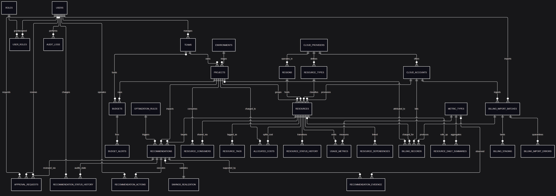

Slide 5
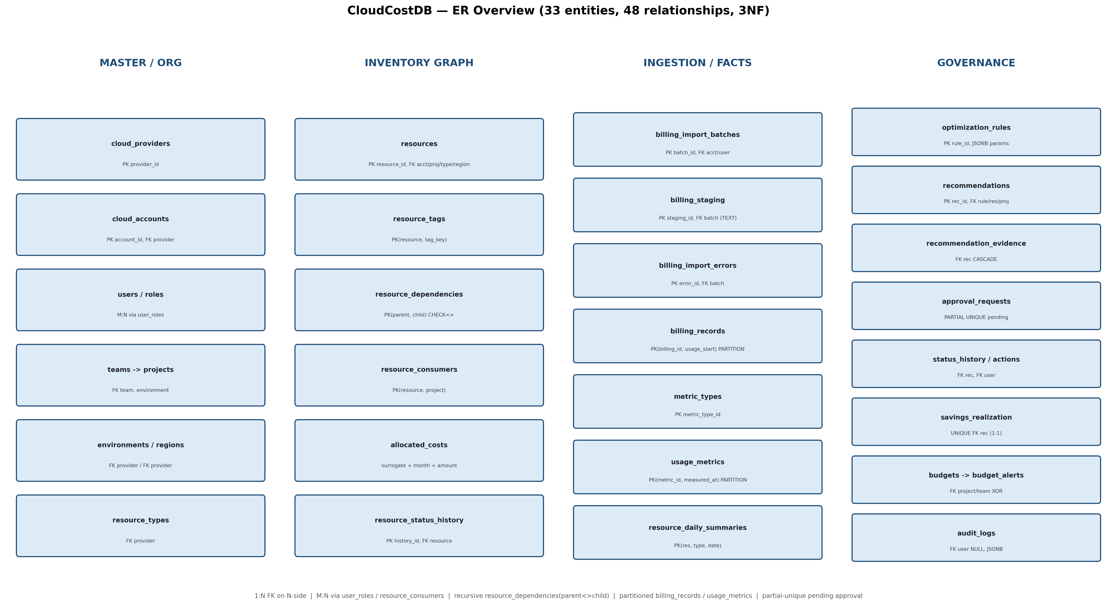
ER Diagram — Entities and Relationships Only
er_overview.png from 00_full_no_attrs.mmd (33 entities, 48 rels)
Notes:
Trace provider-account-resource-project-team. Recursive, M:N, nullable orphans.

Slide 6
Relational Schema (1 of 3) — Master and Inventory
PK/FK from relational_schema.md 2a
cloud_providers(provider_id, provider_name[UK], api_endpoint_url, is_active)
cloud_accounts(account_id, provider_id[FK], account_name, external_account_id, currency_code, is_active)
users(user_id, email[UK], username, password_hash, first_name, last_name, is_active, created_at)
roles(role_id, role_name[UK], description, permissions)
user_roles(user_id[PK,FK], role_id[PK,FK], assigned_at) — M:N junction
teams(team_id, team_name[UK], cost_center[UK], manager_user_id[FK], created_at)
projects(project_id, team_id[FK], environment_id[FK], project_name, description, is_active, created_at)
environments(environment_id, environment_code[UK], is_production_grade)
regions(region_id, provider_id[FK], region_code, region_name, continent, is_active)
resource_types(type_id, provider_id[FK], raw_service_code, raw_type_name, generic_category, pricing_unit)
resources(resource_id, account_id[FK], project_id[FK NULL orphans], type_id[FK], region_id[FK], ext_id, name, status, created/deleted, hourly_cost)
resource_tags(resource_id[PK,FK], tag_key[PK], tag_value) — weak 1NF CASCADE
resource_dependencies(parent[PK,FK], child[PK,FK], dependency_type, created_at) — recursive
resource_consumers(resource_id[PK,FK], project_id[PK,FK], allocation_percentage) — M:N
resource_status_history(status_history_id, resource_id[FK], previous/new, transition_time, reason)
Notes:
1:N FK on N-side, M:N composite PK, weak FK in PK, nullable orphans.

Slide 7
Relational Schema (2 of 3) — Ingestion and Time-Series
Partition PKs include partition key
billing_import_batches(batch_id, account_id[FK], imported_by[FK], file_name, checksum, imported_at, row/accepted/rejected, status)
billing_staging(staging_id, batch_id[FK], all payload TEXT)
billing_import_errors(error_id, batch_id[FK], raw_row_index, raw_payload JSONB, error msg, rejected_at)
billing_records(billing_id[PK], usage_start[PK partition], account_id[FK], resource_id[FK NULL], project_id[FK NULL], batch[FK], service, usage_end, qty, cost, currency)
metric_types(metric_type_id, metric_name[UK], unit, aggregation_method)
usage_metrics(metric_id[PK], measured_at[PK partition], resource_id[FK], metric_type_id[FK], metric_value)
resource_daily_summaries(resource_id[PK,FK], metric_type_id[PK,FK], summary_date[PK], avg/max/min, sample_count)
optimization_rules(rule_id, rule_name[UK], rule_type, description, severity, is_active, parameters JSONB)
3NF: billing keeps project_id only; team via join.
Notes:
COPY TEXT staging then typed facts, pruning, quarantine, rollups.

Slide 8
Relational Schema (3 of 3) — Governance and Audit
Partial-unique, FOR UPDATE, 1:1 savings
recommendations(recommendation_id, rule_id[FK], resource_id[FK], project_id[FK], type, problem, suggested, saving, risk, status, detected/expires)
recommendation_evidence(evidence_id, rec[FK CASCADE], metric[FK NULL], obs_start/end, observed/threshold, narrative)
approval_requests(approval_id, rec[FK], requested_by[FK], reviewed_by[FK NULL], decision NULL=pending, comments, requested/reviewed) + PARTIAL UNIQUE(rec) WHERE pending
recommendation_status_history(history_id, rec[FK], changed_by[FK], old/new, changed_at, reason)
recommendation_actions(action_id, rec[FK], executed_by[FK], action_type, exec_status, started/completed, error JSONB)
savings_realization(realization_id, rec[FK UNIQUE 1:1], baseline/actual/est/actual, pct, start/end, calculated_at)
allocated_costs(allocated_cost_id, resource[FK], project[FK], month, pct, amount)
budgets(budget_id, project[FK NULL], team[FK NULL], month, amount>0, warning) CHECK(one NOT NULL)
budget_alerts(alert_id, budget[FK CASCADE], triggered_at, threshold, spend, amount, ack)
audit_logs(audit_id, user[FK NULL system], action/entity/entity_id, old/new JSONB, timestamp, IP)
DDL: schema.sql 308 lines, 33 tables + 2 DEFAULT partitions, psql -f schema.sql
Notes:
Race FOR UPDATE, one pending, savings UNIQUE, budget XOR, audit append-only.

